Slide 1
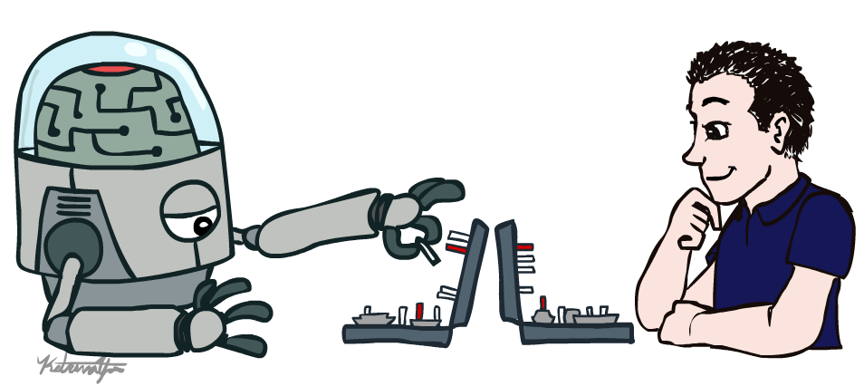
Artificial Intelligence

Slide 2
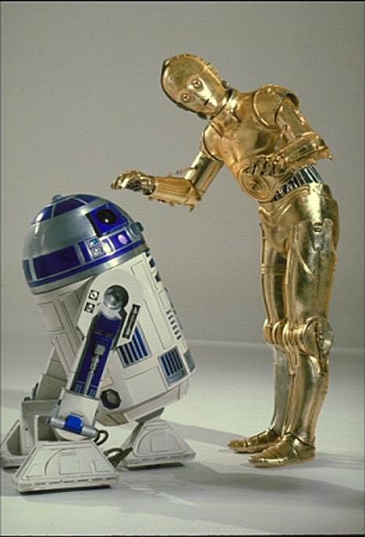
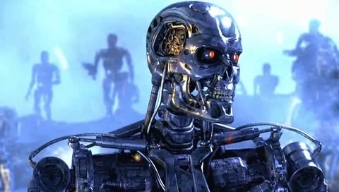
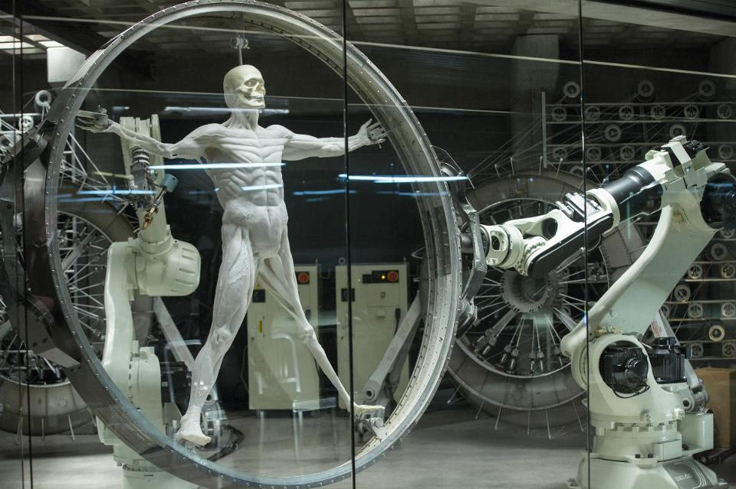
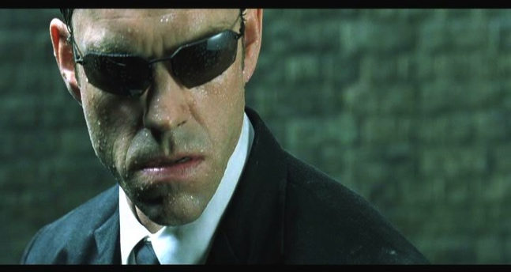
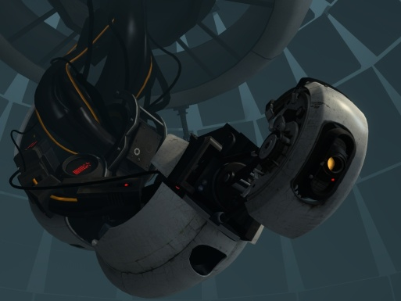
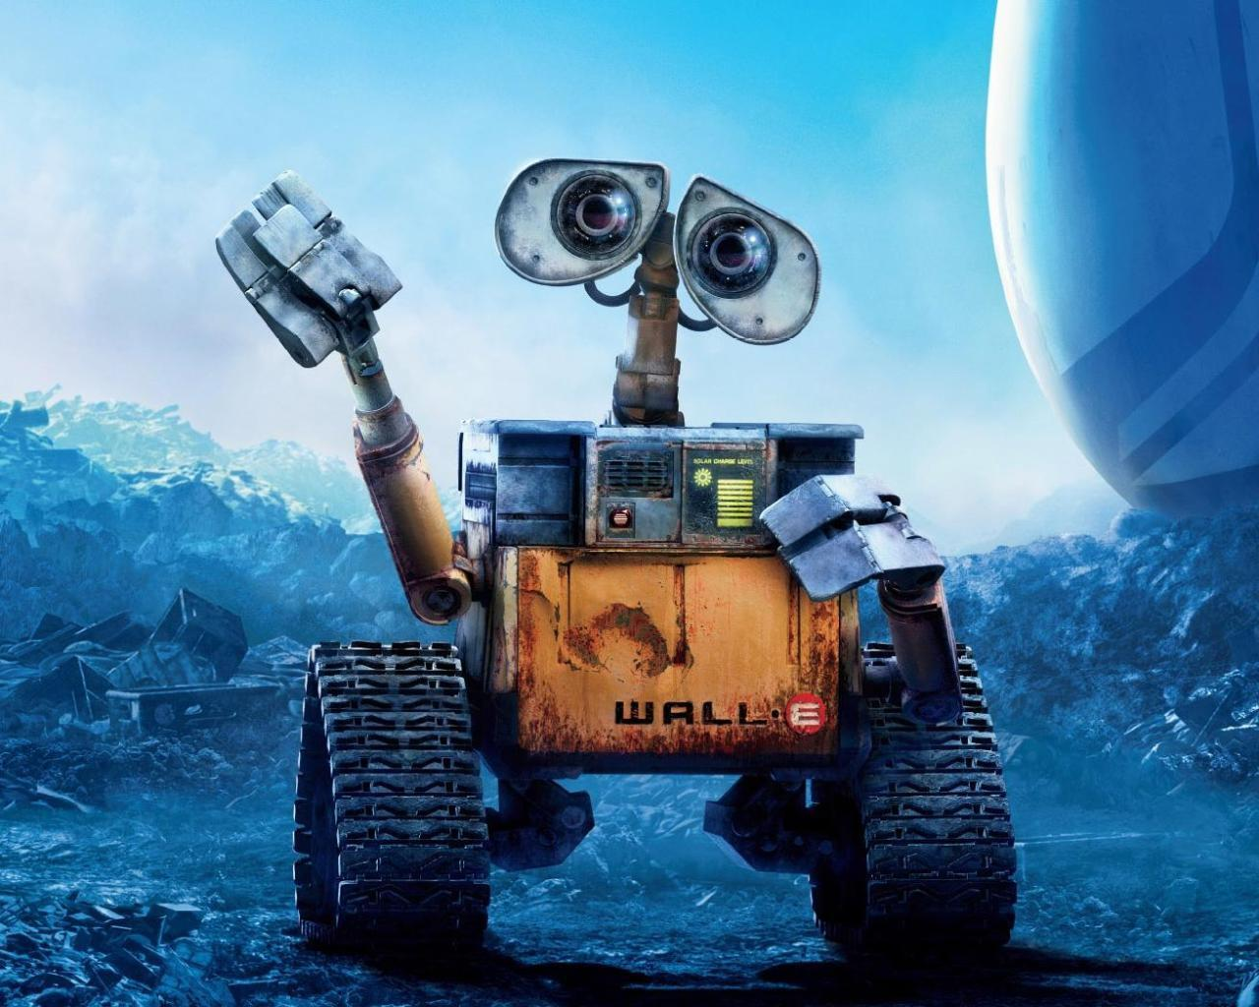
Sci-Fi AI?

Slide 3
Notes:
Robots look like this. We have autonomous cars that figure out how to take us to our destination

Slide 4
Notes:
Robots help nurses in hospitals deliver stuff to different rooms

Slide 5
Notes:
Or drones that record cool videos of us as we do outdoor activities
So what is powering all of this? That’s what this course is for.

Slide 6
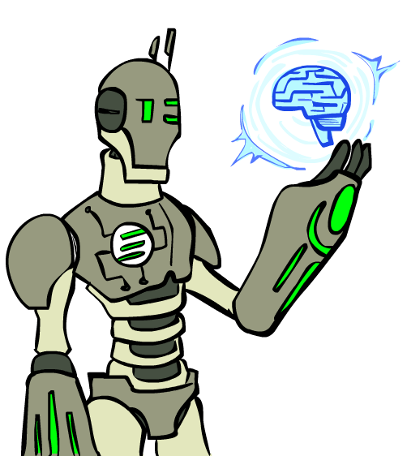
Today
What is this course?
What is artificial intelligence?
History of AI
What can AI do?

Slide 7
About Course
Text Book:
Artificial Intelligence: A Modern Approach. Third Edition. – Stuart Russell and Peter Norvig (AIMA)
References:
Building Problem Solvers – K.D.Forbus and J.D.Kleer
Knowledge Representation and Reasoning– R. Brachman & H. Levesque
Artificial Intelligence. Third Edition – Patrick Winston

Slide 8
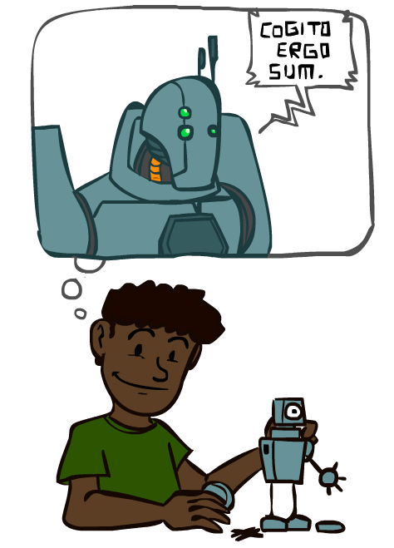
A (Short) History of AI

Slide 9
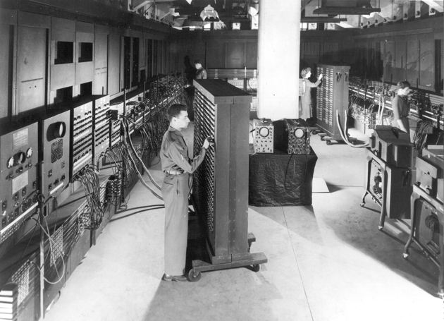
ENIAC (1940s)

Slide 10
Early AI: 1940-1950
1943- McCulloch and Walter Pitts- Neural Network

Slide 11
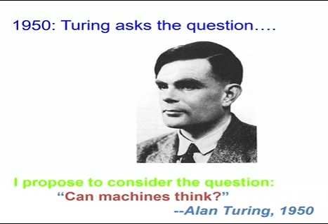
Turing Test-1950s

Slide 12
Early AI: 1950—70
1950s: Early AI programs, including Samuel's checkers program, Newell & Simon's Logic Theorist, Gelernter's Geometry Engine
1956: Dartmouth meeting: “Artificial Intelligence” adopted as a separate field
4 people: John McCarthy, Marvin Minsky, Claude Shannon and Nathaniel Rochester.
The Dartmouth Summer Research Project on Artificial Intelligence was a 1956 summer workshop widely considered to be the founding event of artificial intelligence as a field.
1958: LISP by John McCarrthy. Became a dominant AI language.

Slide 13
Early AI: 1950—70
1964: First Chat bot- Eliza-psychotherapist
1965: Robinson's complete algorithm for logical reasoning
1966: Shakey- the general purpose mobile robot at Stanford research institute
“Look ma, no hands!” era- John McCarthy

Slide 14

Notes:
From the 1950s with early computer engineers https://www.youtube.com/watch?v=aygSMgK3BEM
[dated 1961]

Slide 15
Knowledge-based approaches: 1970—90
1969—79: Early development of knowledge-based systems
Failure of neural network
Poor speech understanding
Failed machine translation (Russian to English)
Caused cancelation of govt. funds
1980—88: Expert systems industry booms
Decline of LISP
1988—93: Expert systems industry busts: “AI Winter”
1988- Backpropagation

Slide 16
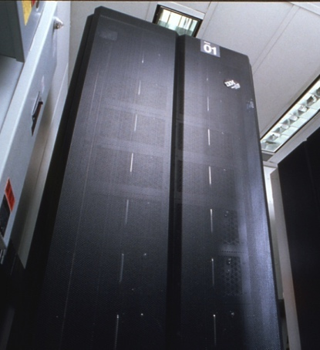
Statistical approaches + subfield expertise: 1990—2012
1996: EQP (an algorithm) proves Robbins algebra are Booleans
1997: Deep blue wins chess vs Gary Kasparov
“I could feel human level intelligence across room- Gary Kasparov”
“Deep Blue hasn't proven anything.”
“If it works it is not AI”
But now can a human defeat the machine in a series of game??????
Early 2000s: Resurgence of probability, focus on uncertainty
2005: DARPA- Driverless car (first working demonstration)
Agents and learning systems… “AI Spring”?
Notes:
Deep blue made by IBM
Mechanical Turk

Slide 17
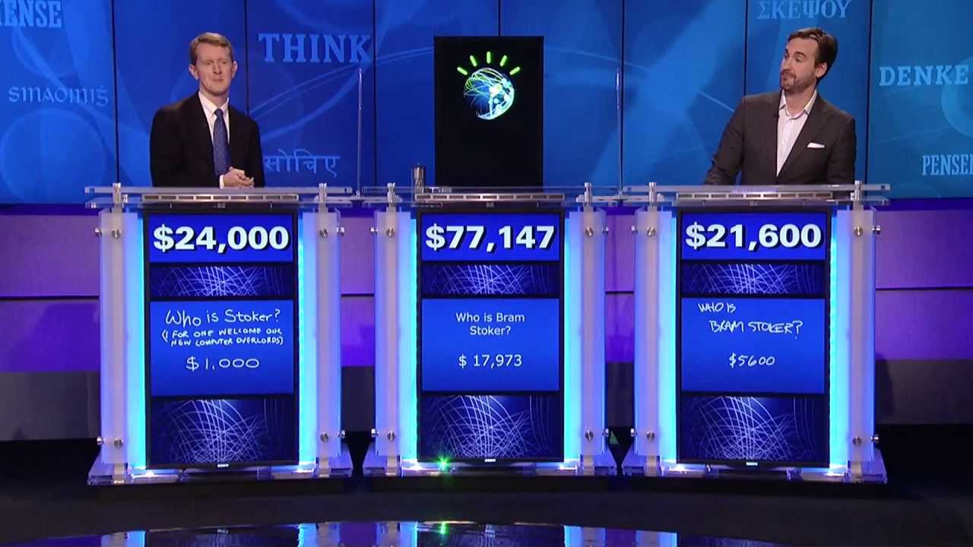
Present AI: 2010s to present
2011: IBM Watson won the Jeopardy vs Ken Jennings and Brad Rutter
“I, for one, welcome our new computer overlords,” - Ken Jennings
Big data, big compute, neural networks
Some re-unification of subfields
AI used in many industries

Slide 18
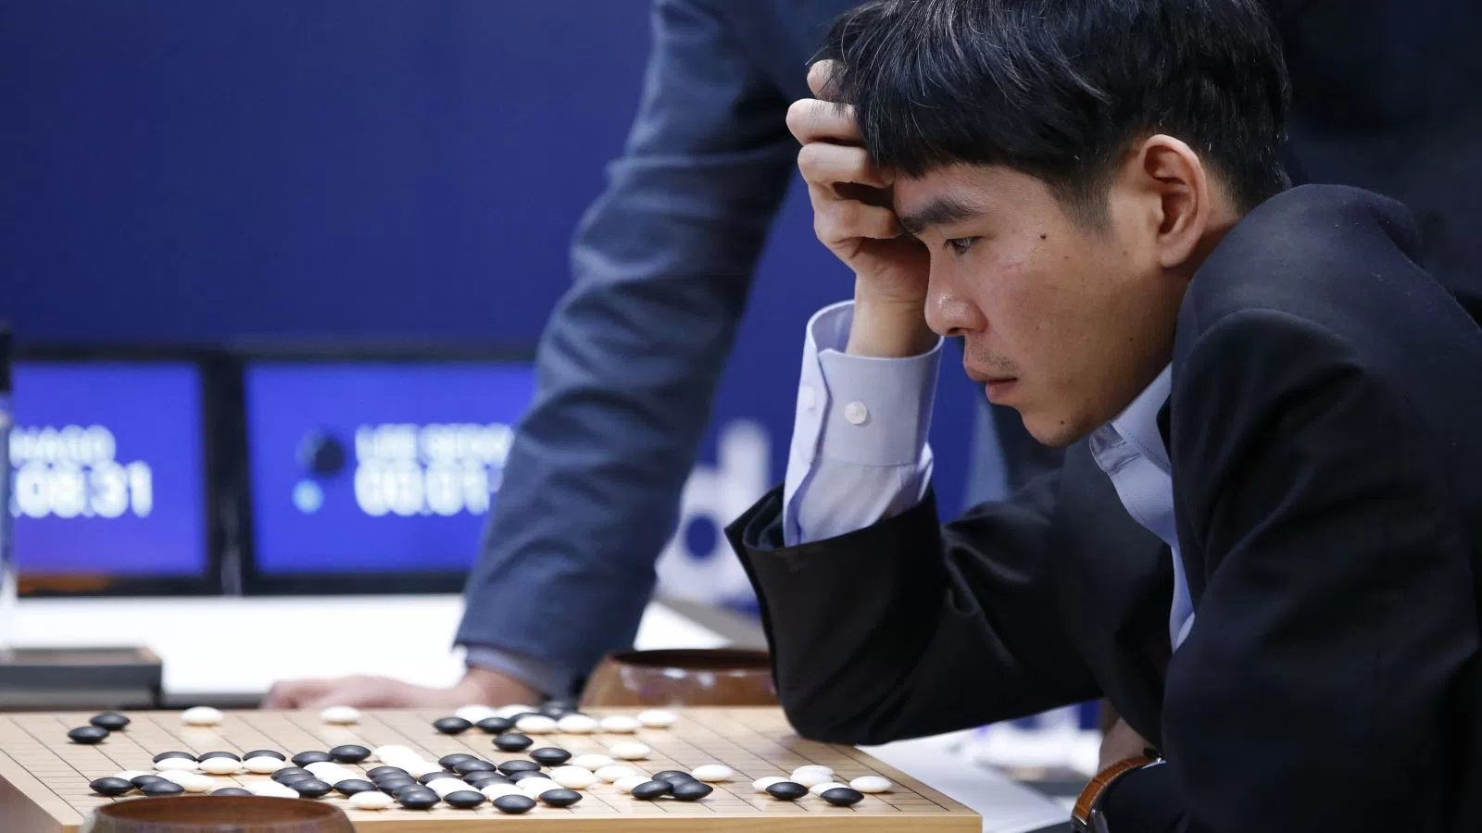
2016:Alpha Go
Lee Se-dol while playing with the AI
Notes:
Go!
For example, Go has 32,490 first moves compared to Chess’s 400 (and longer games).
Lee Se-dol
Add transitions

Slide 19
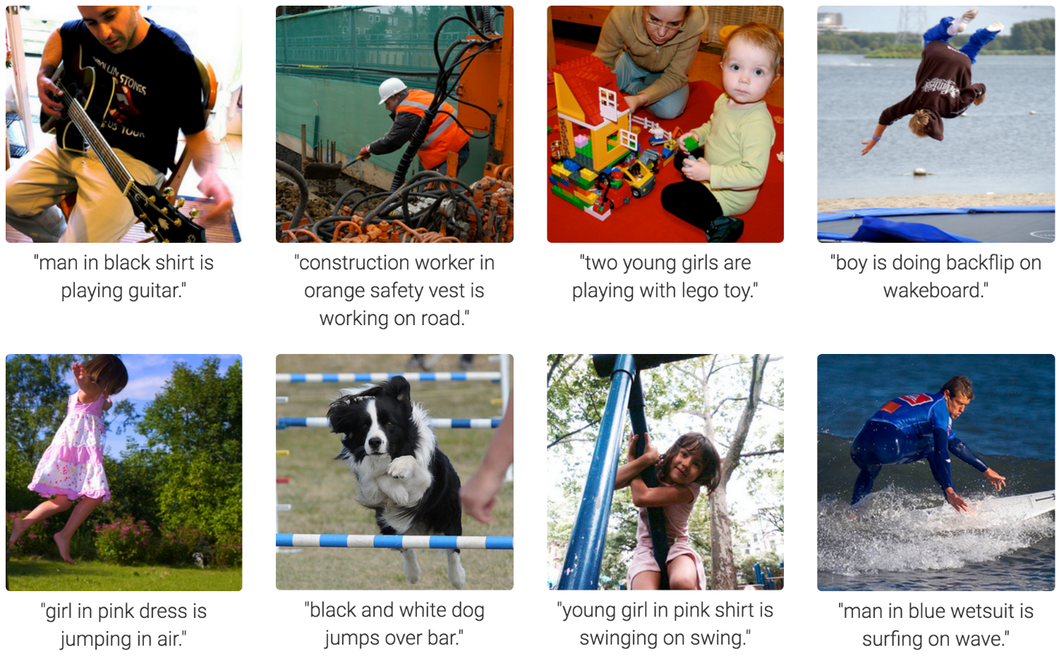
Computer Vision
Karpathy & Fei-Fei, 2015; Donahue et al., 2015; Xu et al, 2015; many more
Notes:
Very Impressive:
Form of prediction and deicion.

Slide 20
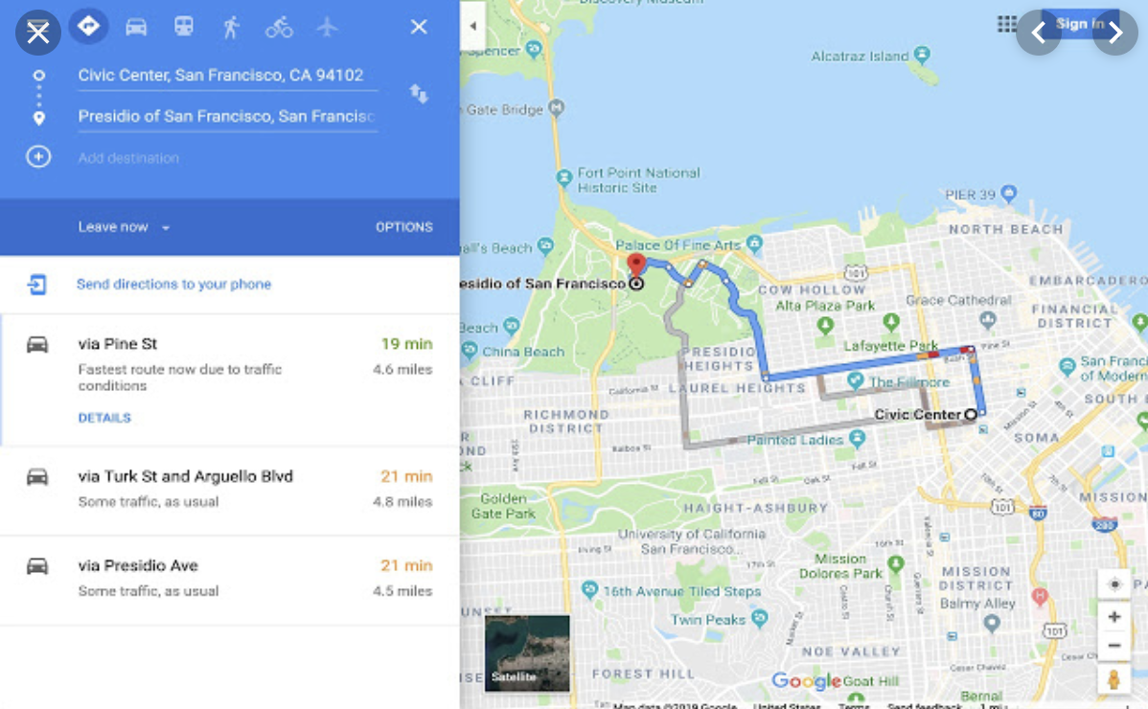
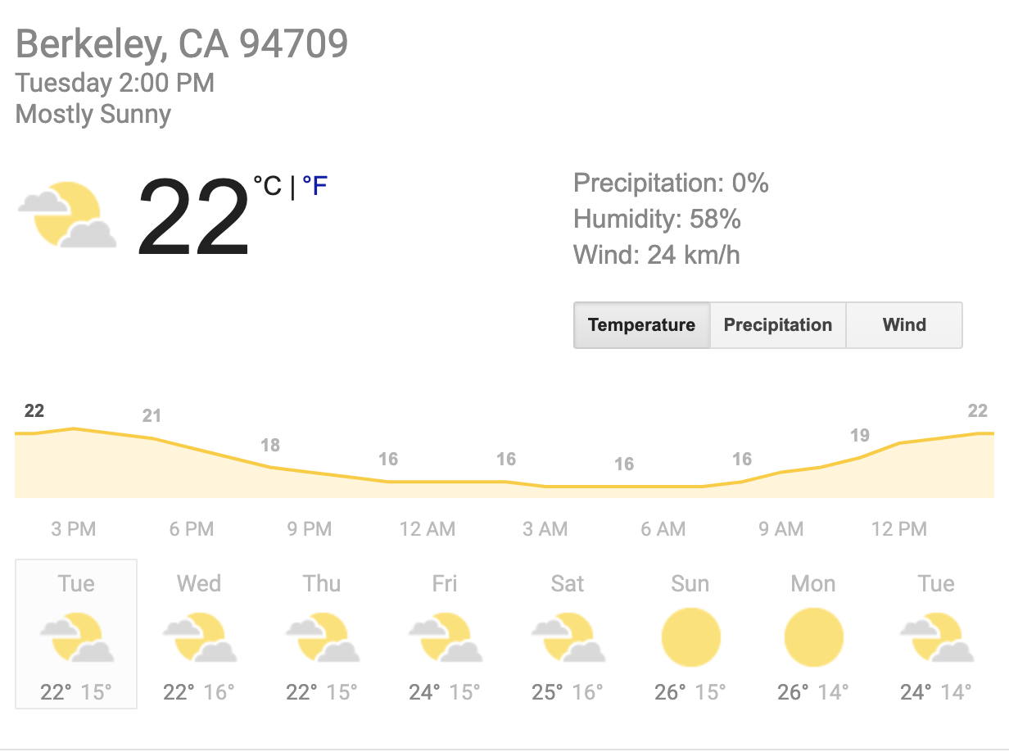
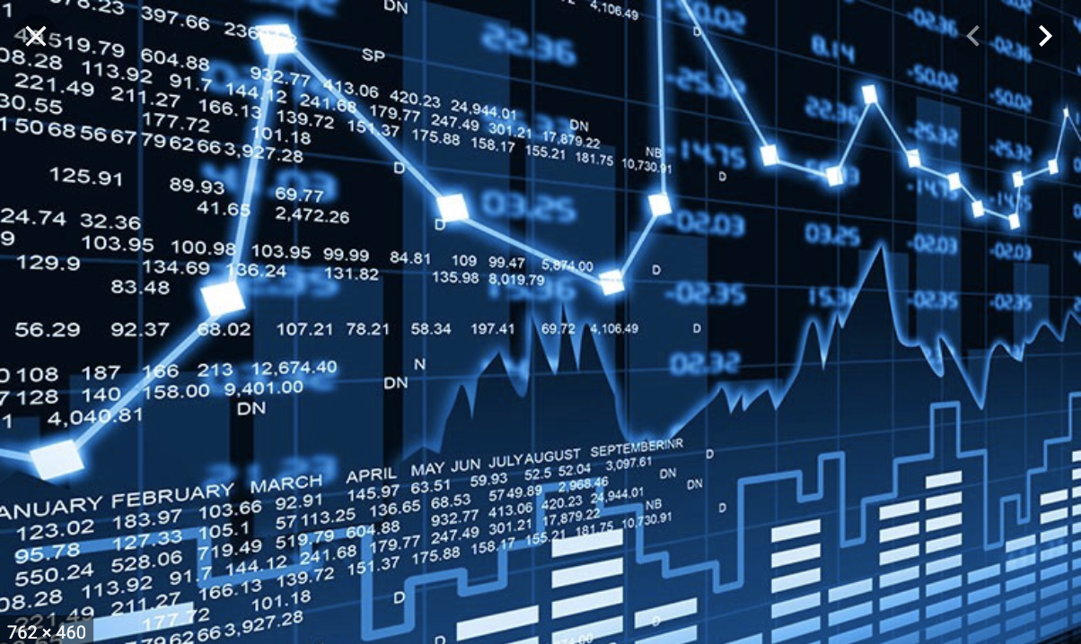
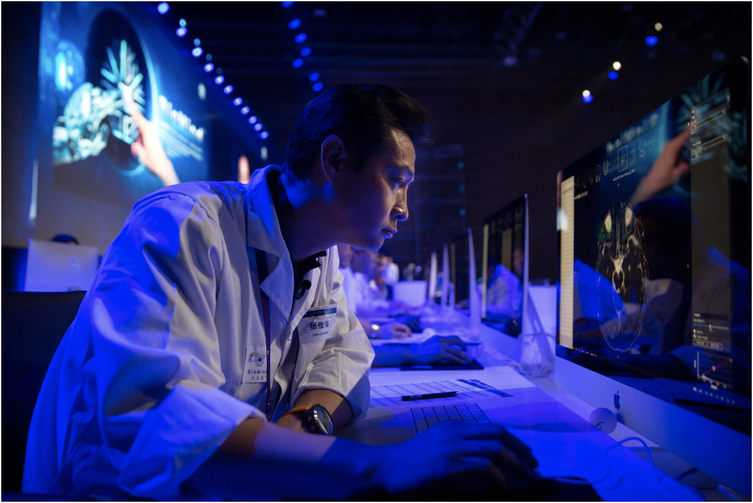
Tools for Predictions & Decisions
Notes:
Many more tools for prediction: Google maps, netflix (amazing recommendation engine)

Slide 21
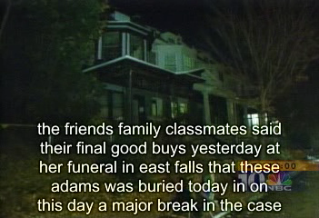
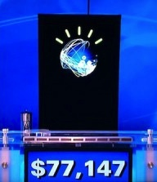
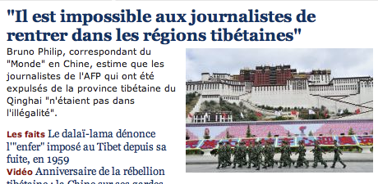
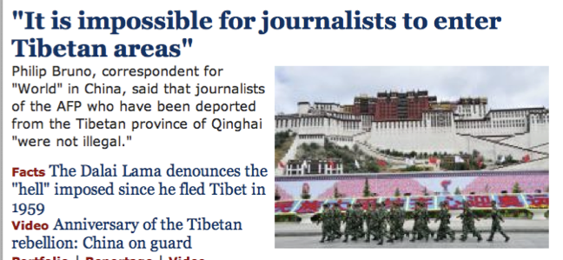
Natural Language
Speech technologies (e.g. Siri)
Automatic speech recognition (ASR)
Text-to-speech synthesis (TTS)
Dialog systems
Language processing technologies
Question answering
Machine translation
Web search
Text classification, spam filtering, etc…
https://play.aidungeon.io/
Notes:
Deepfake
chatbot examples
Do you know about IBM watson, Ken Jennings. Impressive because...
Expensive wayto win $70k
Figure out what she said, pertty good, hard to get intent
engaged in day to day basis
My favorite application is AI dungeon – you write commands to your fictional character and it becomes sort of like a book.
I can’t wait for something like this to work with images or clips (where technology is not far behind)

Slide 22
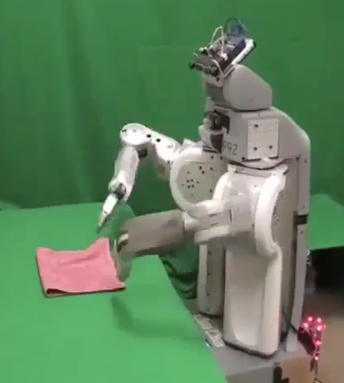
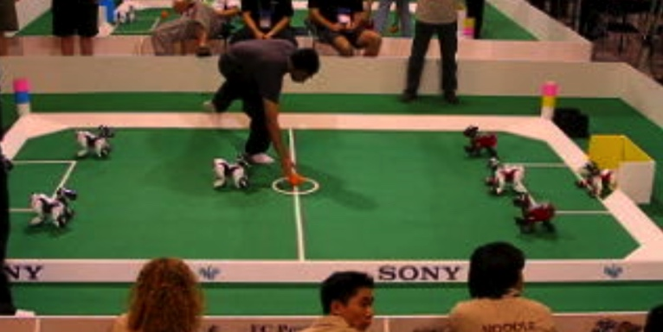
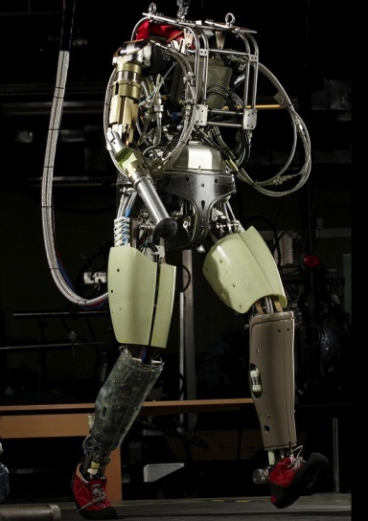
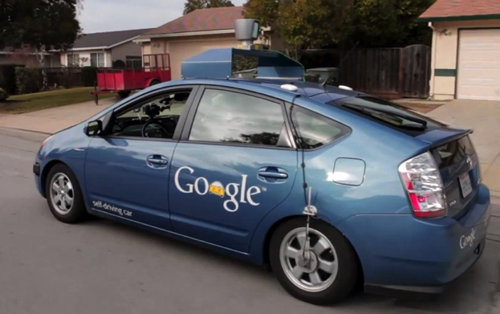
Robotics
Robotics
Part mech. eng.
Part AI
Reality much
harder than
simulations!
Technologies
Vehicles
Rescue
Help in the home
Lots of automation…
In this class:
We ignore mechanical aspects
Methods for planning
Methods for control
Images from UC Berkeley, Boston Dynamics, RoboCup, Google

Slide 23
If it works its not AI
It’s all AI

Slide 24
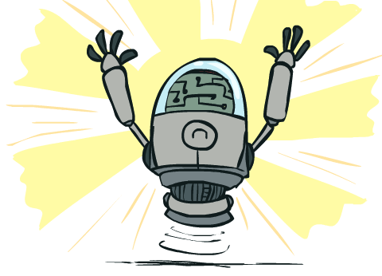
What Can AI Do?
Quiz: Which of the following can be done at present?
Play a decent game of Jeopardy?
Win against any human at chess?
Win against the best humans at Go?
Play a decent game of tennis?
Grab a particular cup and put it on a shelf?
Unload any dishwasher in any home?
Drive safely along the highway?
Drive safely along Telegraph Avenue?
Buy a week's worth of groceries on the web?
Buy a week's worth of groceries at Berkeley Bowl?
Discover and prove a new mathematical theorem?
Perform a surgical operation?
Translate spoken Chinese into spoken English in real time?
Write an intentionally funny story?

Slide 25
How so much increase???
DATA
Computational Power
Algorithms

Slide 26
Artificial Intelligence
AI: What is the nature of intelligent thought?
What is intelligence?????
Dictionary meaning: capacity for learning, reasoning, understanding and similar for of mental activity
Ability to perceive and act in the world
Reasoning: Proving theorems, Medical Diagnosis
Planning: Take decisions
Learning and Adaptation: Recommend Movies, learn traffic Patterns
Understanding: Text, speech, visual scene

Slide 27
Are human intelligent??????
Are human always intelligent??????????
Can non-human behavior be intelligent??????

Slide 28
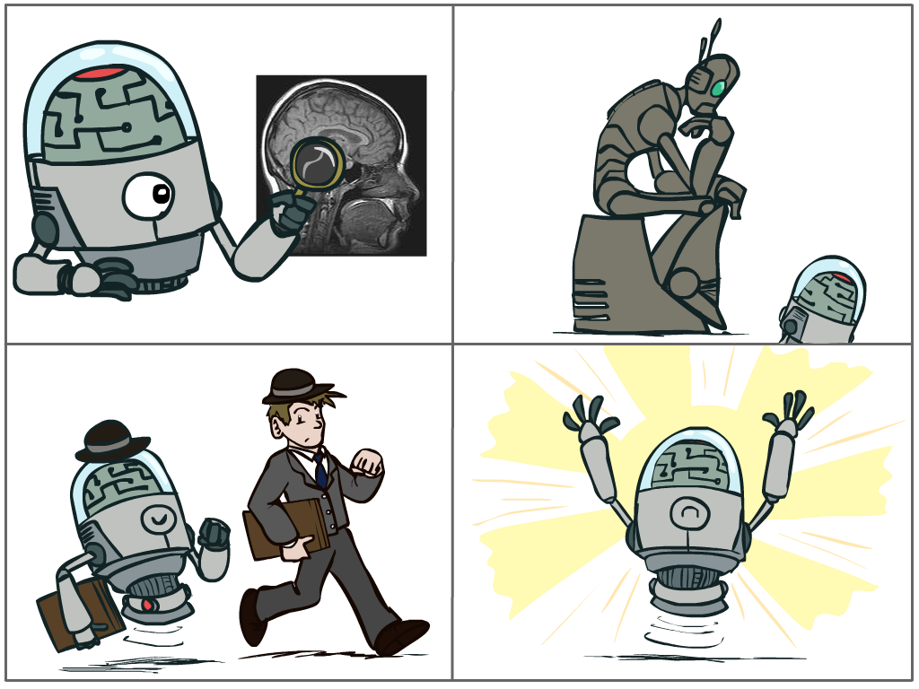
What is AI?
The science of making machines that:
Think like people
Think rationally
Act like people
Act rationally

Slide 29
Acting humanly
Turning Test
Do you want machine to make human like errors????
Thinking humanly
Cognitive modeling
(very hard to understand how human think)
Intelligent tutor
Elderly healthcare bot
Thinking Rationally
Laws of thought (Logic and reasoning, inferences and conclusion)
Purposeful thinking?
Acting Rationally
Rational behavior: Doing right thing
What is rationality??
Notes:
Robotic reflex---obstacle avoidance

Slide 30
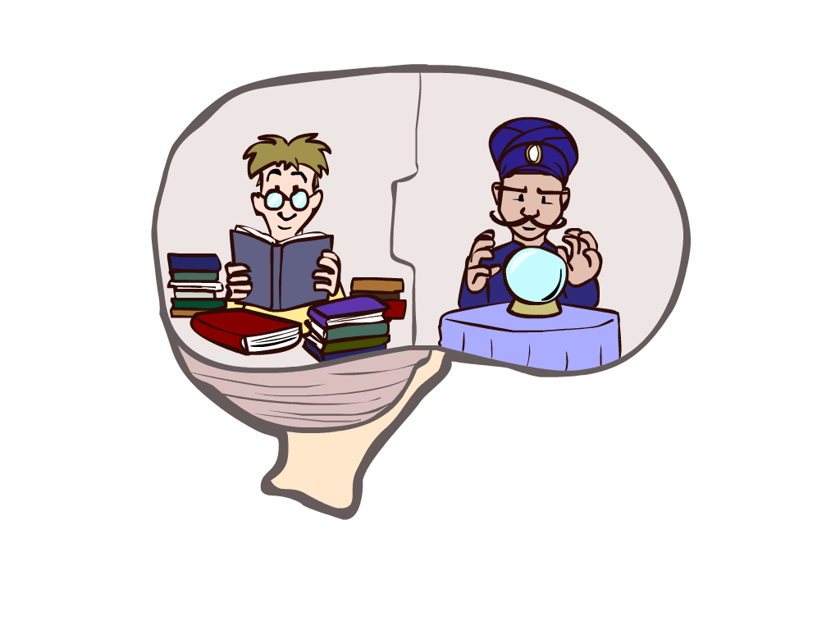
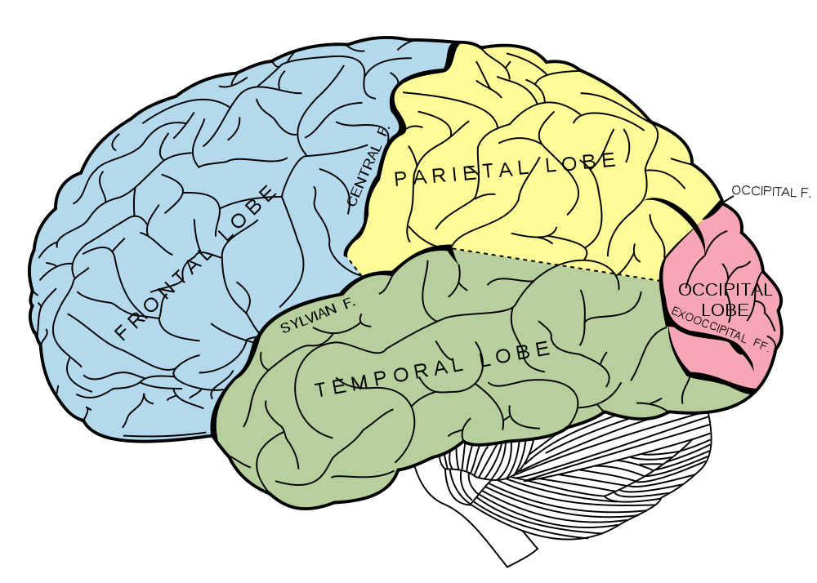
What About the Brain?
Brains (human minds) are very good at making rational decisions, but not perfect
Brains aren’t as modular as software, so hard to reverse engineer!
“Brains are to intelligence as wings are to flight”
Lessons learned from the brain: memory (data) and simulation (computation) are key to decision making

Slide 31
Rational Agents
An agents should strive to do right thing, based on what it can perceive and the actions it can perform.
The right action is the one that will cause the agent to be the most successful
Performance measure: An objective criterion for success of an agent’s behavior
For example: performance measure of a vacuum cleaner agent could be the amount of dirt cleaned up, time taken, electricity consumed, etc.
Notes:
Agents are organism or internet organism

Slide 32
Ideal Rational Agents
“For each possible percept sequence, does whatever action is expected to maximize its performance measure on the basis of evidence perceived so far and built in knowledge”
RATIONALITY vs OMINISCIENCE???
Acting in order to obtain information
Notes:
Agents are organism or internet organism

Slide 33
Rational Decisions
We’ll use the term rational in a very specific, technical way:
Rational: maximally achieving pre-defined goals
Rationality only concerns what decisions are made
(not the thought process behind them)
Goals are expressed in terms of the utility of outcomes
Being rational means maximizing your expected utility
A better title for this course would be:
Computational Rationality

Slide 34
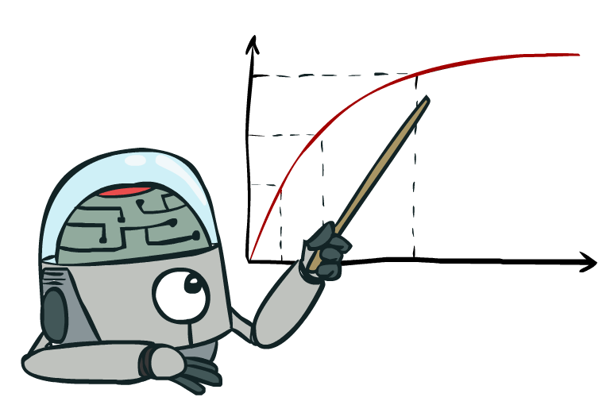
Maximize Your
Expected Utility

Slide 35
Maximize Your
Expected Utility
Notes:
Consequences of an action, context, other actors around
Convex Opt

Slide 36
Maximize Your
Expected Utility
Notes:
Related to -
Utilitarianism (Consequntialism) – Jeremy Bentham
Utility rather than values, could be
Virtue Ethics – Aristotle
Deontology (Duty based ethics)

Slide 37
Maximize Your
Expected Utility

Slide 38
Maximize Your
Expected Utility
Notes:
Very end – who is your? How do you get that?
Does the agent serve us? Important when figuring out if the agent is helping - many cues from philosophy here.
What is an agent that is good about acting for itself? Humans!
Replicating the brain would be an AI, right?

Slide 39
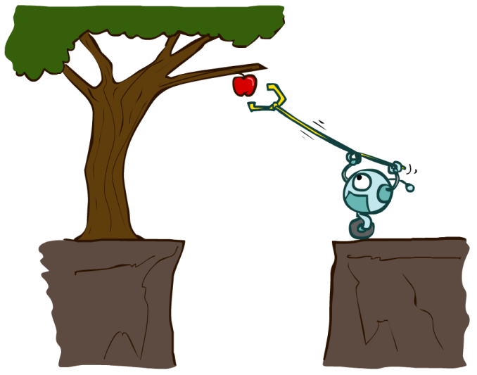
Designing Rational Agents
An agent is an entity that perceives and acts.
A rational agent selects actions that maximize its (expected) utility.
Characteristics of the percepts, environment, and action space dictate techniques for selecting rational actions
This course is about:
General AI techniques for a variety of problem types
Learning to recognize when and how a new problem can be solved with an existing technique
Sensors
Agent
Percepts
Environment
?
Actuators
Actions
Notes:
Quick recap: what will we do in this class?

